Slide 1
Regularization

Slide 2
Noise
irrelevant, erroneous, or random variations in data that do not represent the true underlying pattern
mislead models causing them to
learn incorrect relationships
perform poorly on new, unseen data

Slide 3
Impact of Noise on ML Models
Overfitting:
Models may memorize noise instead of learning true patterns
Reduced Generalization:
Poor performance on unseen data
Unstable Training:
High gradient variance, slower convergence

Slide 4
Types of noise
Input Noise (Feature Noise)
Errors or distortions in the input features.
Examples:
Sensor errors (e.g., pixel corruption in images).
Typos or mislabeled categories in tabular data.
Background noise in speech recognition.
Output Noise (Label Noise)
Incorrect labels in supervised learning.
Examples:
Human annotation mistakes (e.g., labeling a cat as a dog).
Automated labeling errors (e.g., web-scraped data with wrong tags).

Slide 5
Types of noise (Continued…)
Intrinsic Noise (Model-Induced Noise)
Randomness introduced by the learning process itself.
Examples:
Stochasticity in optimization (e.g., SGD updates).
Dropout in neural networks (random deactivation of neurons).

Slide 6
Intrinsic noise
Generates
Gradient variance
Gradient oscillation

Slide 7
Gradient Variance
Measures how much the gradients fluctuate across different batches (in SGD) or across different training steps
High variance means gradients change significantly between updates, leading to unstable training
Causes:
Small batch sizes (each batch has different gradient estimates)
Noisy or imbalanced data (some samples produce very different gradients)
Poorly conditioned optimization landscapes (e.g., sharp loss curvatures)

Slide 8
Gradient Variance (continued…)
Impact:
High variance → Unstable training, harder convergence
Too low variance (e.g., full-batch GD) → May converge to sharp minima (overfitting risk)
Solutions:
Increase batch size (reduces variance but may hurt generalization)
Use gradient clipping (limits extreme updates)
Apply momentum (smooths gradient updates)

Slide 9
Gradient Oscillation
Refers to consistent back-and-forth fluctuations in gradient directions (rather than random variations).
Often seen when the learning rate is too high or the loss landscape has steep slopes.
Causes:
Too high learning rate → Overshooting optimal updates.
Ill-conditioned optimization (e.g., different weights have very different optimal learning rates).
Poor weight initialization (e.g., some weights dominate early training).

Slide 10
Gradient Oscillation (Continued…)
Impact:
Slows convergence (model keeps bouncing around minima)
May prevent convergence if oscillations are too large
Solutions:
Reduce learning rate or use learning rate scheduling.
Use adaptive optimizers (Adam, RMSprop) to normalize updates.
Apply momentum (dampens oscillations).

Slide 11
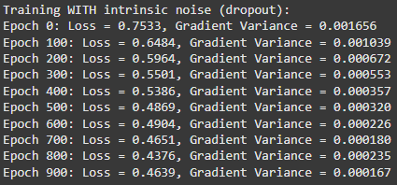
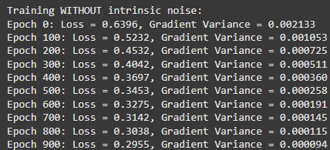
Training with and without intrinsic noise

Slide 12
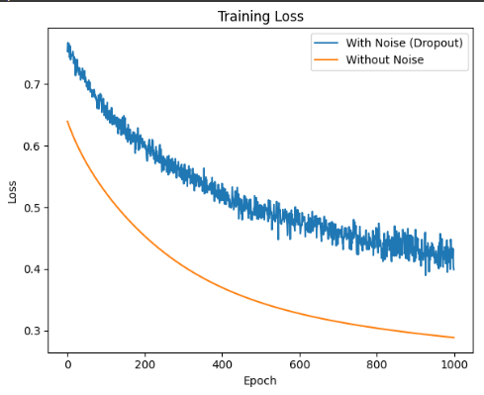
Training loss with and without noise

Slide 13
Gradient variance and Gradient Oscillation
Feature | Gradient Variance | Gradient Oscillations
Definition | Random fluctuations across batches/steps. | Consistent back-and-forth swings in gradient direction.
Cause | Small batches, noisy data. | High learning rate, ill-conditioned loss landscape.
Effect | Unstable training, noisy updates. | Slow convergence, bouncing around minima.
Solution | Larger batches, gradient clipping. | Lower learning rate, adaptive optimizers.

Slide 14
Variance and Oscillations effects
High Variance + Oscillations
→ Very unstable training (common in deep RL, GANs)
Low Variance + Oscillations
→ Model may still struggle to converge (needs better optimization tuning)
Balanced Variance + Minimal Oscillations
→ Smooth, fast convergence (ideal case)

Slide 15
High gradient variance
→ Unstable training
→ Risk of overfitting
Controlled gradients (via regularization, normalization, proper optimization)
→ Smoother convergence
→ Better generalization

Slide 16
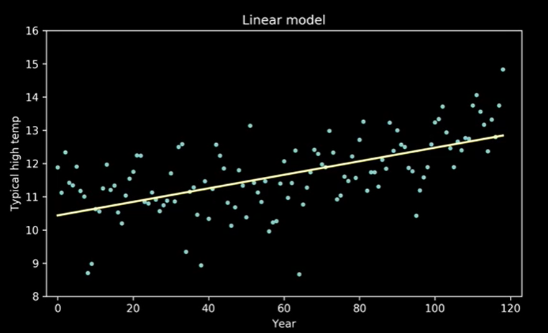
High Bias

Slide 17
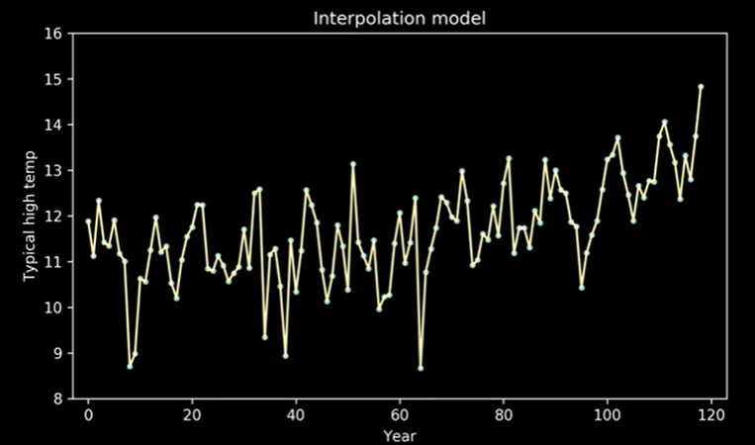
High Variance

Slide 18
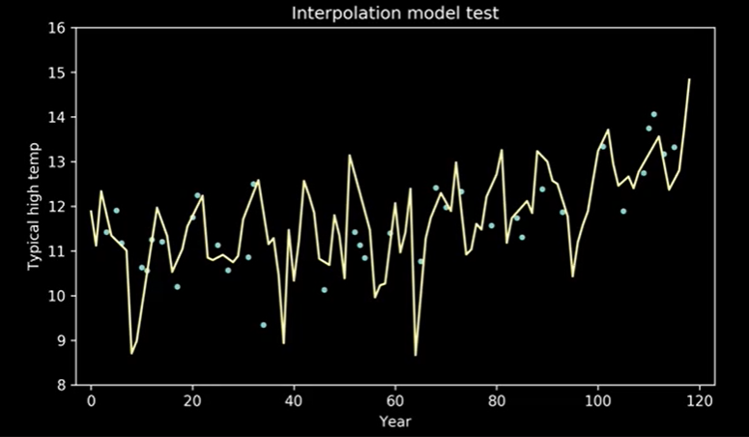
Overfitting result in low performance in unseen data

Slide 19
Characteristics of overfitting
High Training Accuracy, Low Test Accuracy – The model performs exceptionally well on training data but fails on test/validation data
Overly Complex Model – The model has too many parameters relative to the amount of training data, making it fit even random fluctuations
Poor Generalization – The model fails to make accurate predictions on new, real-world data.

Slide 20
Causes of overfitting
Too Few Training Samples – Not enough data to capture true patterns
Excessively Complex Model (e.g., deep neural networks with too many layers)
Training for Too Long (common in deep learning, leading to "memorization")
Noisy or Irrelevant Features – The model tries to fit meaningless variations

Slide 21
Preventing overfitting
Use More Training Data – Helps the model generalize better
Simplify the Model – Reduce complexity (e.g., fewer layers/nodes in neural networks)
Regularization (L1/L2) – Penalizes large weights to avoid extreme adjustments
Cross-Validation – Ensures the model performs well on unseen data
Early Stopping – Halts training before the model starts overfitting
Dropout (for Neural Networks) – Randomly deactivates neurons to prevent reliance on specific features
Feature Selection – Remove irrelevant/noisy features.

Slide 22
For a model with parameters θ = (θ₁, θ₂, ..., θₙ), the standard loss function is:
L(θ) = (1/m) * Σ[loss(yⁱ, f(xⁱ;θ))] for i=1 to m
Where
m is the number of training examples
yⁱ is the true label
f(xⁱ;θ) is the model's prediction.

Slide 23
L1 Regularization (Lasso Regression)
Adds a penalty term proportional to the absolute value of the coefficients
L₁(θ) = L(θ) + λ * Σ|θⱼ| for j=1 to n
Effects:
Can drive some coefficients to exactly zero (feature selection)
Creates sparse models
Useful when you suspect many features are irrelevant

Slide 24
L1 Regularization (Continued…)
Gradient (for gradient descent):
The gradient of the L1 penalty term is λ * sign(θⱼ),
where sign(θⱼ) is:
+1 if θⱼ > 0
-1 if θⱼ < 0
Undefined at 0 (in practice, often treated as 0)

Slide 25
L2 Regularization (Ridge Regularization)
Adds a penalty term proportional to the square of the magnitude of the coefficients
L₂(θ) = L(θ) + λ * (1/2) * Σ(θⱼ²) for j=1 to n
Where:
λ is the regularization parameter
Effects:
Shrinks coefficients toward zero but doesn't set any to exactly zero
Prevents any single feature from having too large an impact
Works well when many features contribute to the outcome

Slide 26
L2 Regularization (Continued…)
Gradient (for gradient descent):
The gradient of the L2 penalty term is simply λθⱼ for each parameter θⱼ

Slide 27
Elastic Net Regularization
Combines both L1 and L2 regularization
L_elastic(θ) = L(θ) + λ₁ * ||θ||₁ + λ₂ * (1/2) * ||θ||₂²

Slide 28
Different cases for tuning values of lambda1 and lamda2
If lambda1 and lambda2 are set to be 0, Elastic-Net Regression equals Linear Regression.
If lambda1 is set to be 0, Elastic-Net Regression equals Ridge Regression.
If lambda2 is set to be 0, Elastic-Net Regression equals Lasso Regression.
If lambda1 and lambda2 are set to be infinity, all weights are shrunk to zero

Slide 29
Bias-Variance Tradeoff
Bias: Error caused by over simplistic assumptions of the data
Variance: Error caused by the model being too sensitive to small changes in the training data.

Slide 30
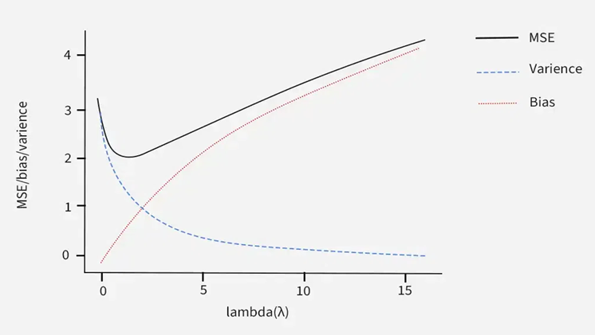
Bias-Variance Tradeoff in L1 (Lasso)

Slide 31
Bias-Variance Tradeoff in L1 (Lasso) (continued…)
penalty reduces variance by making the coefficients of less important features to zero. This prevents overfitting by ensuring model doesn't fit to noise in the data.
However increasing regularization strength i.e raising the lambda value can increase bias. This happens because a stronger penalty can cause the model to oversimplify making it unable to capture the true relationships in the data leading to underfitting.
Thus the goal is to choose right lambda value that balances both bias and variance through cross validation.

Slide 32
Bias-Variance Tradeoff in L2 (Ridge)

Slide 33
Bias-Variance Tradeoff in L1 (Lasso) (continued…)
penalty reduces variance by making the coefficients of less important features near to zero. This prevents overfitting by ensuring model doesn't fit to noise in the data.
However increasing regularization strength i.e raising the lambda value can increase variance leading to underfitting.
Thus the goal is to choose right lambda value that balances both bias and variance through cross validation.

Slide 35
